Slide 1
What does Auto Tune actually do?
It helps us to calibrate our VARA FM Station
Definition of a calibrated VARA FM Station:
  A calibrated VARA FM station is first, a station that has set its Transmit Audio Drive Level so that its receive Signal-to-Noise (S/N) ratio at the distant end station is adequate to recover the message data.
  And second, a calibrated VARA FM station is also a station that has set its Receive Audio Drive Level so that it can recover the distant end station's message data.

Slide 2
Transmit Audio Drive Level
  The transmit audio drive level must be set to not overdrive or underdrive the audio signal that modulates the carrier.
  An overdriven transmit audio signal will spread the FM carrier bandwidth out beyond the detection bandwidth of the receiver and thus reduces the receive signal level needed to successfully demodulate and decode the digital data.
  The VARA FM Terminal Node Controller AUTO TUNE operation assists you in setting the transmit audio drive level
Receive Audio Drive Level
  The receive audio level must be set to not overdrive the Analog-to-Digital Converter (ADC) which is the soundcard chip.

Slide 3
Auto Tune sets the Frequency Deviation (F_{dev}) of the FM Carrier
What is F_{dev} ?
F_{dev} is a variable that defines the highest and lowest transmitted frequency of the FM carrier.
That is, it defines the transmission bandwidth of the FM carrier

Slide 4
What controls the F_{dev} ?
ANSWER: the Transmit Audio Drive Level

Slide 5
Transmit Audio Drive Level sets the
FM Carrier Frequency Deviation which in turn
defines the FM Transmission Bandwidth

Slide 6
This can be illustrated using Carson’s Rule
The FM Carrier Bandwidth is approximated by Carson’s Rule
Carson’s Rule: BW _{FM TX} = 2 x (highest voice frequency + F_{dev})
F_{dev} = Frequency deviation which dictates the highest & lowest frequency of the Frequency Modulated carrier
And, it is the Transmit Audio Drive Level that sets the Frequency Deviation

Slide 7
In amateur radio mobile and HT voice communications the F_{dev} typically does not exceed 5 kHz
If the highest voice frequency is 3 kHz, using Carson’s Rule
BW _{FM TX} = 2 x ( 3 kHz + 5 kHz)
BW _{FM TX} = 16 kHz
Where, the highest transmitted frequency = (Fc + 8 kHz)
And the lowest frequency transmitted frequency = (Fc – 8 kHz)
Typical amateur FM radios support 15 kHz – 16 kHz voice transmissions

Slide 8
VARA FM Winlink data communications uses the same mobile and HT rigs we amateurs use for voice communications
Therefore, the VARA FM Winlink transmission bandwidth must stay in the same 15 kHz to 16 kHz range so that the data message can be successfully recovered at the receiving station.

Slide 9
Carson’s Rule applies to VARA FM Winlink data communications
Carson’s Rule: BW _{FM TX} = 2 x (Baseband Audio BW + F_{dev})
What is the VARA FM Winlink Baseband Bandwidth?
Specifically, what is the VARA FM NARROW Baseband Bandwidth?
We’ll address the VARA FM WIDE Baseband Bandwidth, later.

Slide 10
Deriving the VARA FM Winlink Baseband Audio Bandwidth
Baseband Audio BW = (symbol rate) x (number of carriers)
The bandwidth of the modulated audio carrier is approximately = symbol rate
VARA FM NARROW Level 11
  There are 58 modulated audio carriers being transmitted simultaneously during a message transmission.
  The 58 carriers are Orthogonally Frequency Division Multiplexed (OFDM) together.
Level 11 Baseband Audio BW ≈ 2500 Hz
Baseband Audio BW = 42 Hz x 58 carriers
Baseband Audio BW = 2436 Hz
Maximum VARA FM NARROW Baseband BW with guard band on he left and right will be approximately 2500 Hz
VARA FM Speed Table

Slide 11
For VARA FM NARROW communications the frequency deviation should not exceed 5 kHz
Therefore, using Carson’s Rule
BW _{FM TX} = 2 x ( 2.5 kHz + 5 kHz) = 15 kHz

Slide 12
Overdriving the Transmit Audio Amplitude will cause the F_{dev} to exceed 5 kHz
A VARA FM NARROW carrier transmission greater than 15 or 16 kHz will result in lost or attenuated received signal energy needed to successfully demodulate and decode the data message.

Slide 13
In this example the transmit audio is over driven such that F_{dev} = 10 kHz
BW _{FM TX} = 25 kHz
Results in reduced
received S/N

Slide 14
So how do we keep this from happening?
ANSWER – We calibrate our VARA FM Winlink Station

Slide 15
How do we calibrate our VARA FM Winlink Station?
ANSWER – We run the Auto Tune operation

Slide 16
So what is the Auto Tune operation doing to help us calibrate our VARA FM WL Station
The Auto Tune function actually sets the Frequency Deviation of our transmitted signal
How? – while incrementally increasing the Terminal Node Controller (TNC) drive level it measures the resulting receive S/N at the distant end station
and then sets the TNC drive level that produces the highest S/N

Slide 17
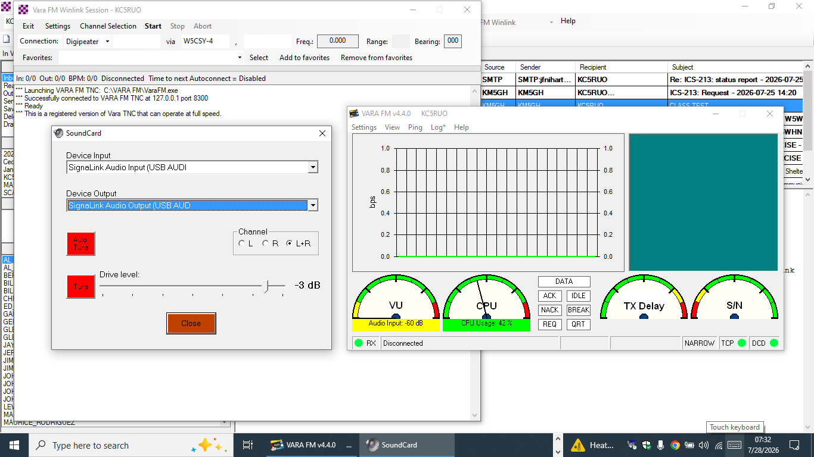
Auto Tune gradually increases the Transmit Audio Drive Level by increasing the Terminal Node Controller’s Drive Level

Slide 18
With each incrementally increasing transmit audio amplitude level the receive signal – to – noise (S/N) at the distant end station is measured and reported.
The transmit audio drive level is then “fine tuned” with adjustments the radio operator is instructed to make to the Microsoft Audio Output (SPEAKERS, PLAYBACK) sound setting or to the SignaLink Transmit Gain Control
When APPROVED, your station is fully calibrated

Slide 19
So what about VARA FM WIDE?
The F_{dev} for VARA FM WIDE should not exceed 3 kHz
Carson’s Rule applies here as well:
Carson’s Rule: BW _{FM TX} = 2 x (Baseband Audio BW + F_{dev})
BW _{FM TX} = 2 x (Baseband Audio BW + 3 kHz)

Slide 20
Deriving the VARA FM Winlink Baseband Audio Bandwidth
Baseband Audio BW = (symbol rate) x (number of carriers)
The bandwidth of the modulated audio carrier is approximately = symbol rate
VARA FM WIDE Level 13
  There are 116 modulated audio carriers being transmitted simultaneously during a message transmission.
  The 116 carriers are Orthogonally Frequency Division Multiplexed (OFDM) together.
Level 13 Baseband Audio BW ≈ 5000 Hz
Baseband Audio BW = 42 Hz x 116 carriers
Baseband Audio BW = 4872 Hz
Maximum VARA FM WIDE Baseband BW with guard band on he left and right will be approximately 5000 Hz
VARA FM Speed Table

Slide 21
For VARA FM WIDE communications the frequency deviation should not exceed 3 kHz
Therefore, using Carson’s Rule
BW _{FM TX} = 2 x ( 5.0 kHz + 3 kHz) = 16 kHz

