Slide 1
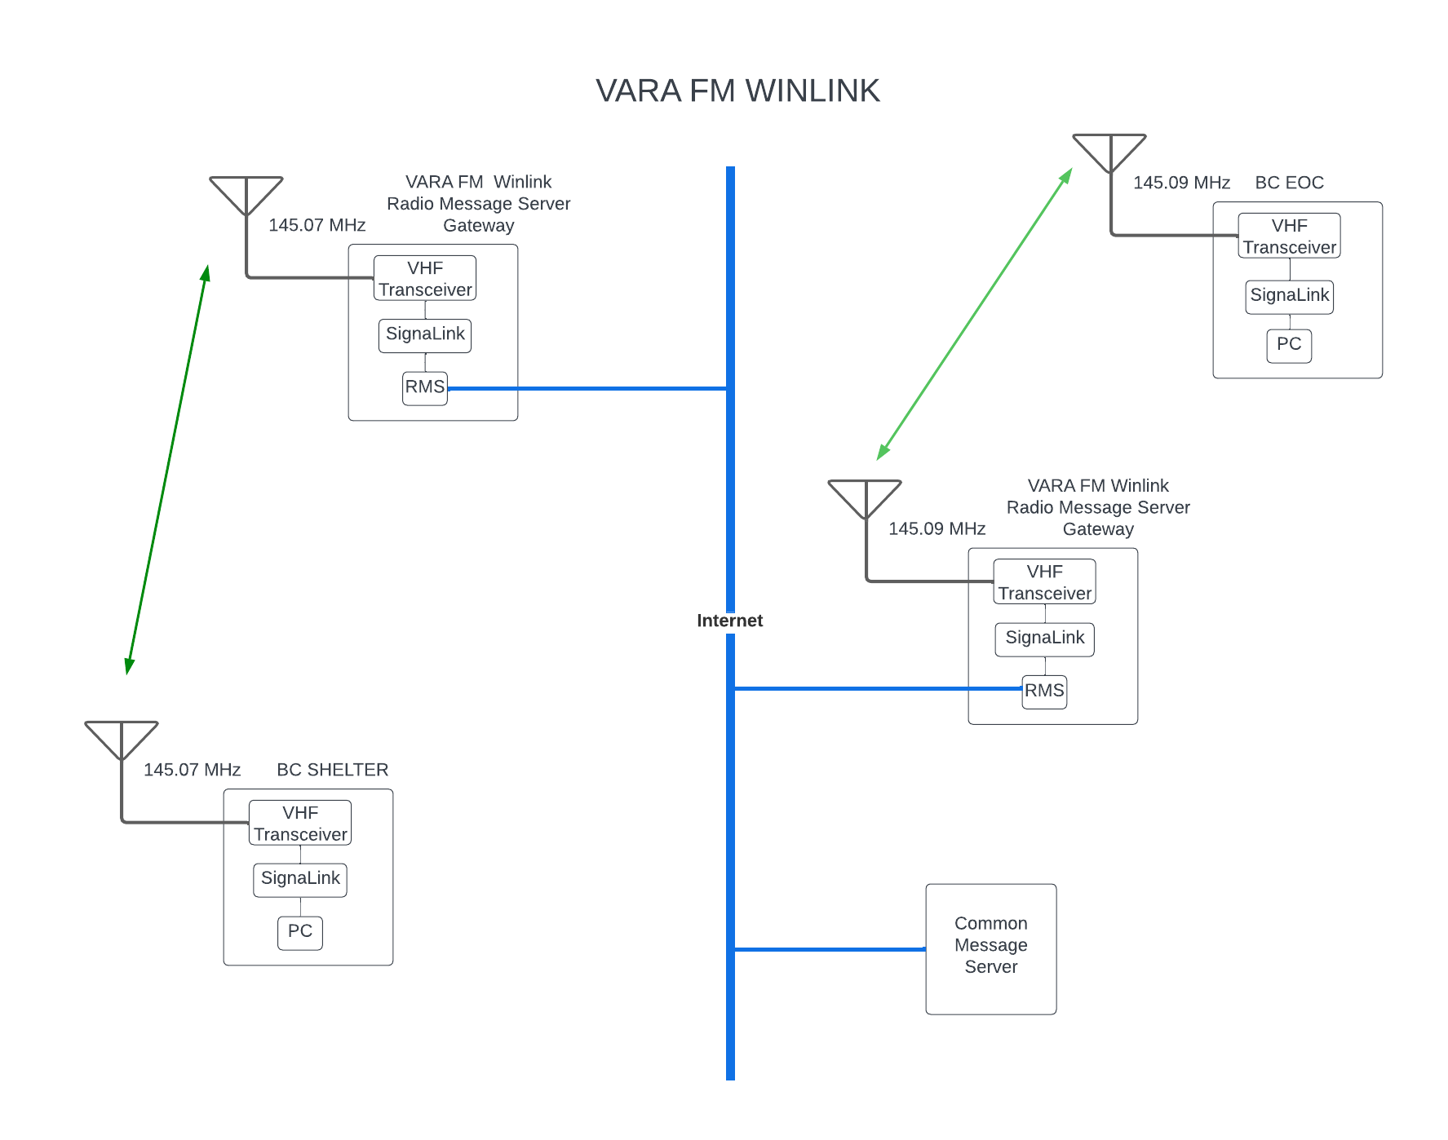
Partially dependent upon the internet
Capable of much higher data rates
Uses the VARA FM Winlink protocol
Notes:
Same functionality as Packet Winlink via the RMS gateways
But email message transactions can take place at higher data rates
REFERENCE THE DIAGRAM and walk through the shelter –to-EOC email transfer using the KC5UKE-5 VARA FM Winlink RMS station on 145.07 MHz and the NM5LS-10 on 145.09 MHz

Slide 2
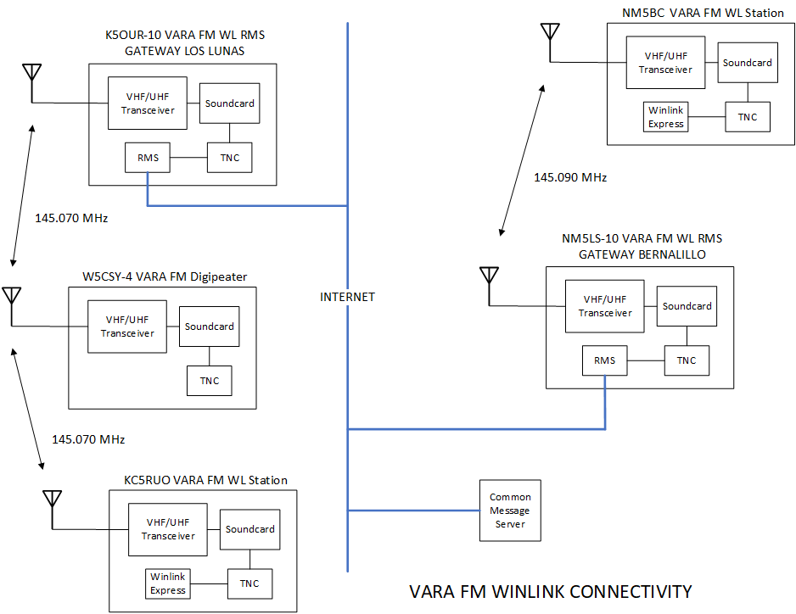

Slide 3
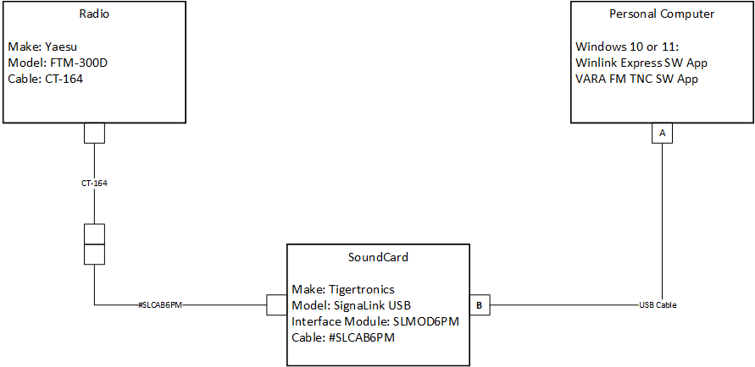
VARA FM Winlink Station Components

