Slide 1
What is the difference between
VARA FM NARROW and VARA FM WIDE

Slide 2
Deriving the VARA FM Winlink Baseband Audio Bandwidth
Baseband Audio BW = (symbol rate) x (number of carriers)
The bandwidth of the modulated audio carrier is approximately = symbol rate
VARA FM NARROW Level 11
  There are 58 modulated audio carriers being transmitted simultaneously during a message transmission.
  The 58 carriers are Orthogonally Frequency Division Multiplexed (OFDM) together.
Level 11 Baseband Audio BW ≈ 2500 Hz
Baseband Audio BW = 42 Hz x 58 carriers
Baseband Audio BW = 2436 Hz
Maximum VARA FM NARROW Baseband BW with guard band on he left and right will be approximately 2500 Hz
VARA FM Speed Table

Slide 3
Deriving the VARA FM Winlink Baseband Audio Bandwidth
Baseband Audio BW = (symbol rate) x (number of carriers)
The bandwidth of the modulated audio carrier is approximately = symbol rate
VARA FM WIDE Level 13
  There are 116 modulated audio carriers being transmitted simultaneously during a message transmission.
  The 116 carriers are Orthogonally Frequency Division Multiplexed (OFDM) together.
Level 13 Baseband Audio BW ≈ 5000 Hz
Baseband Audio BW = 42 Hz x 116 carriers
Baseband Audio BW = 4872 Hz
Maximum VARA FM WIDE Baseband BW with guard band on he left and right will be approximately 5000 Hz
VARA FM Speed Table

Slide 4
VARA FM Winlink Data Communications Frequency Deviation
The F_{dev} for VARA FM NARROW should not exceed 5 kHz
The F_{dev} for VARA FM WIDE should not exceed 3 kHz

Slide 5
Radio Configuration to accommodate
VARA FM NARROW Data Communications
VARA FM NARROW can be supported by amateur radio transceivers that do not have a dedicated data port.
The transmitted audio coming from the analog side of the soundcard is injected into the radio’s microphone jack.
The radio’s external speaker jack is the source of the receive audio that is injected into the analog side of the soundcard.

Slide 6
Radio Configuration to accommodate
VARA FM NARROW Data Communications
The radio is typically configured for 1200 bps operation
This does not mean that the VARA FM NARROW data rates are limited to 1200 bps. It is a naming convention carry over from Packet Radio.
The 1200 bps configuration means the radio is using circuitry that limits the audio bandwidth to 3 kHz

Slide 7
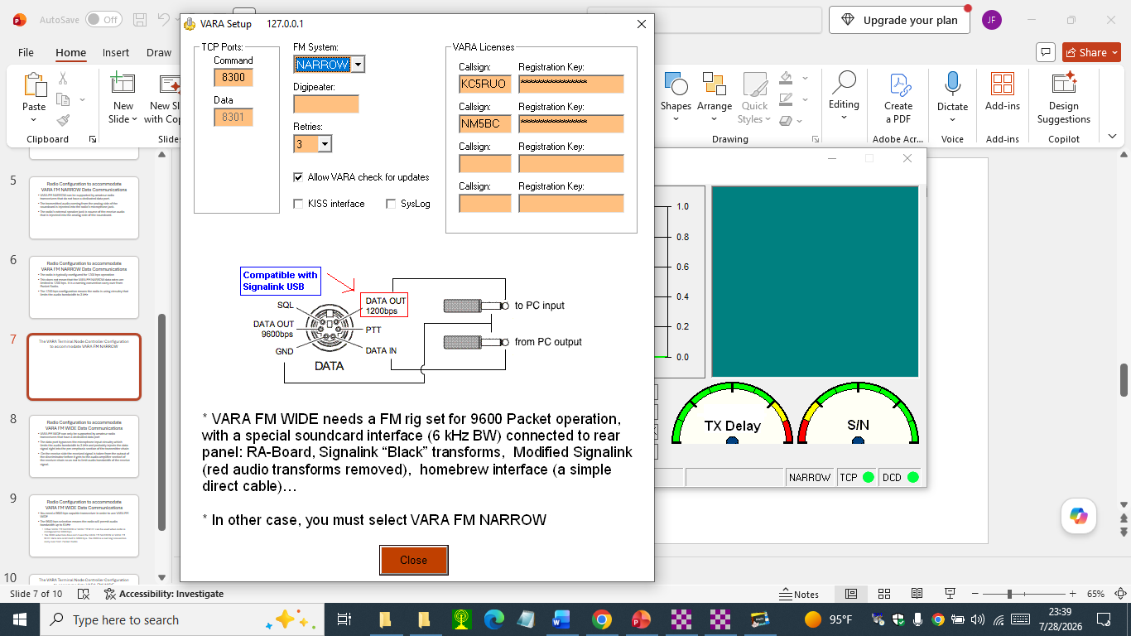
The VARA Terminal Node Controller Configuration to accommodate VARA FM NARROW

Slide 8
Radio Configuration to accommodate
VARA FM WIDE Data Communications
VARA FM WIDE can only be supported by amateur radio transceivers that have a dedicated data port
The data port bypasses the microphone input circuitry which limits the audio bandwidth to 3 kHz and probably injects the data signal right into the pre-emphasis section of the transmitter chain
On the receive side the received signal is taken from the output of the discriminator before it gets to the audio amplifier section of the receiver chain so as not to limit audio bandwidth of the receive signal.

Slide 9
Radio Configuration to accommodate
VARA FM WIDE Data Communications
You need a 9600 bps capable transceiver in order to use VARA FM WIDE
The 9600 bps selection means the radio will permit audio bandwidth up to 6 kHz
  Either VARA FM NARROW or VARA FM WIDE can be used when radio is configured for 9600 bps
  The 9600 selection does not mean the VARA FM NARROW or VARA FM WIDE data rate is limited to 9600 bps. The 9600 is a naming convention carry over from Packet Radio

Slide 10
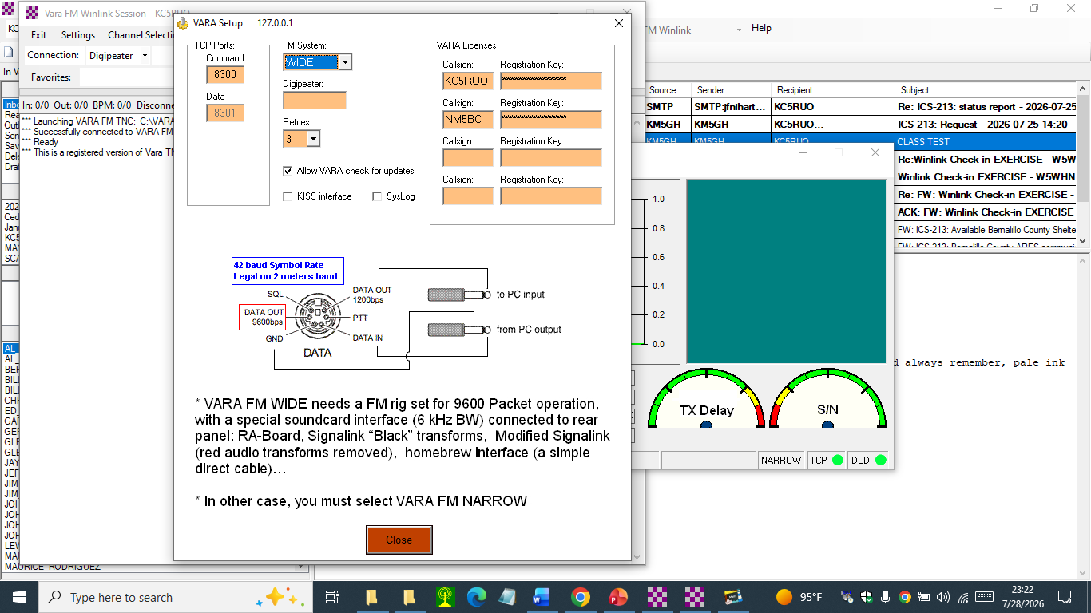
The VARA Terminal Node Controller Configuration to accommodate VARA FM WIDE

