Slide 1
SCARES REPEATERS
Current Status
NM5F/N5HC 10/18/2021

Slide 2
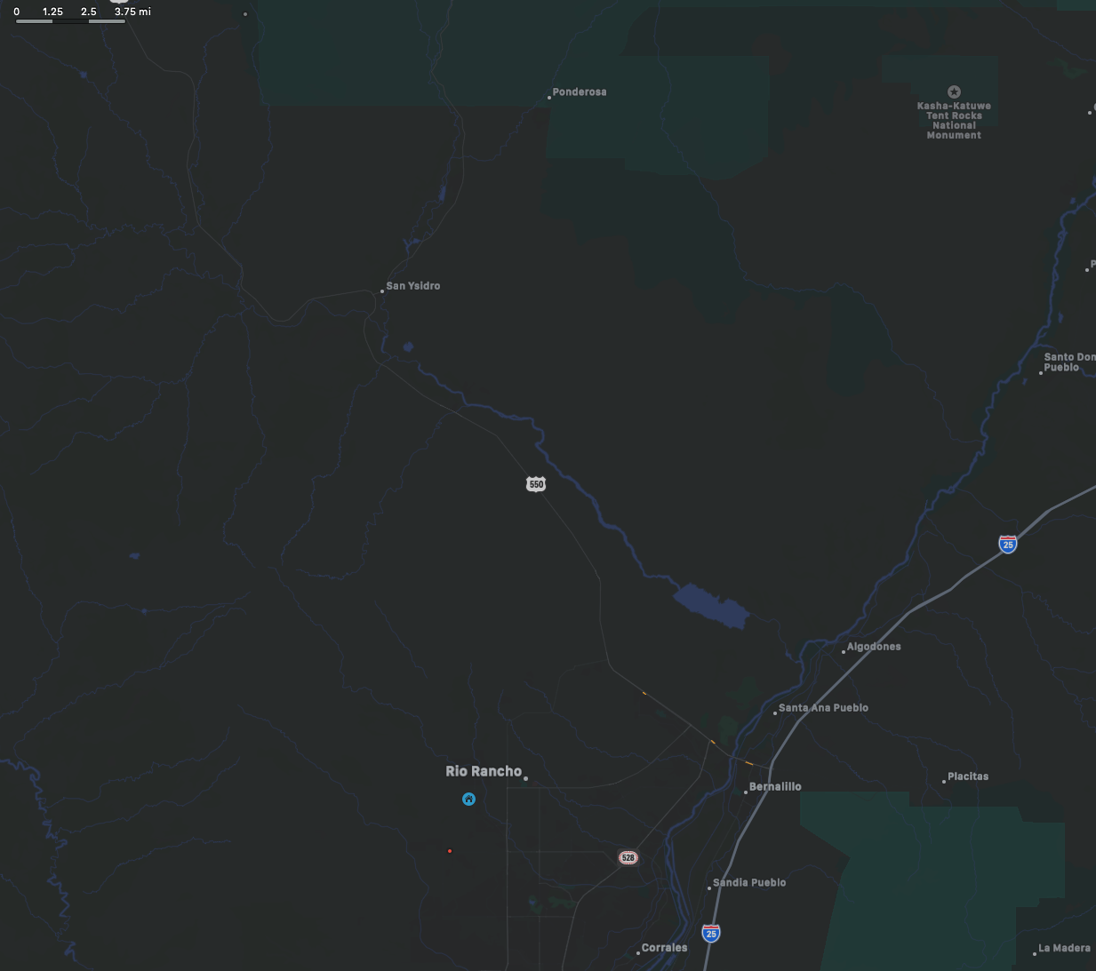
Caption

Slide 3
Pajarito
Racked Equipment
Duplexer
Router
Repeater
Packet Radio
Power Supply
Link Interface
Caption

Slide 4
La Madera
Racked Equipment
Router
Repeater
Link Interface
Duplexer
Batteries? TBD
Caption

Slide 5
Rainbow
Racked Equipment
Duplexer (UHF)
Router
Repeaters
Power Supply
Link Interfaces
Duplexer UHF
Caption

Slide 6
Rainbow
Repeater TX Performance
 | Transmitter Rated Power w/Load
Transmitter Frequency | 147.10000 MHz
Code Plug Tx Power Out (Watts) | 25
Rated Power Meaasured w/Load | 22.3 Watts
Corrected Rated Power w/Load | 25.1 Watts
 | Transmitter Frequency Alignment
Tx Freq. Error Found | 15.00 Hz
Tx Freq. Error Adjusted | 15.00 Hz
 | Transmitter Performance
Deviation (Analog only) | 2.50 kHz
Internal Reference | Operational

Slide 7
Rainbow
System TX Performance
 | Power Output
Code Plug Tx Power Out | 25 Watts (25 Watts)
Station Power Output | 22.3 Watts
Station Reflected Power | 0.2 Watts
Corrected Station Power | 25.1 Watts
 | Duplexer
Duplexer Input | 25.1 Watts
Duplexer Output | 12.5 Watts
Duplexer Reflected Pwr | 0.2 Watts
Corrected Duplexer Output | 14.1 Watts
Duplexer Loss | -2.51 dB (-2.2 dB)
 | Final Power to Antenna
Final CP Tx Power Out (Watts) | 25
Forward Power to Antenna | 12.5 Watts
Antenna Reflected Power | 0.2 Watts
Corrected Antenna Power | 14.1 Watts

Slide 8
Rainbow
Repeater RX Performance
 | Receiver Internal Test
Receiver Frequency | 147.70000 MHz
Receiver Test Result | Pass
 | Receiver Performance
 | Receiver Sensitivty (12dB SINAD)
Receiver Sensitivity | -116.50 dBm (-117.3)
Rx Corrected Sensitivity | -117.00 dBm
 | Duplexer Performance
Duplexer Sens. | -113.00 dBm
Duplexer Corrected Sensitivity | -113.50 dBm
Duplexer Loss | -3.5 dB (-2.2)
 | Carrier Squelch Alignment (Analog only)
Carrier Squelch Level (Analog) | 113.50 dBm

Slide 9
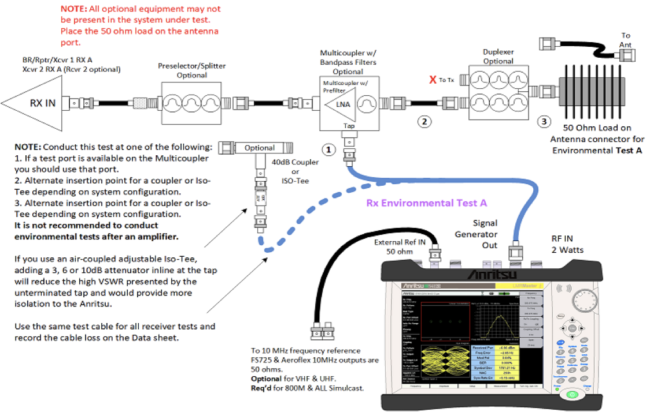
Rainbow
System RX Performance
 | Receiver Environmental Impact
Sensitivity at Rx Ant. Input | -113.50 dBm
Load Sensitivity (Test A) | -72.00 dBm
Test A Corrected | -72.50 dBm
Environmental Effects (Test B) | -67.00 dBm
Test B Corrected | -67.50 dBm
Tx to Rx Desense (Test C) | -67.00 dBm
Effective Receiver Sensitivity | -108.5 dBm
Environmental Degradation | -5.0 dBm
Total Receiver System Loss | -3.5 dB
Caption
Environmental Color Legend: | Acceptable | Caution | Warning
1. Transmitter Desense | Desense < 5dB | Marginal TX Desense > 5dB < 15dB | High TX Desense > 15dB
2. Environmental Degradation | Degradation < 6dB | Marginal Degradation > 6dB < 18dB | High Degradation >18dB

Slide 10
Rainbow
Un-Balance. Typical Amateur 2m Tranciver
42 dBm (14W)
-122dBm
-164 dB
-108 dBm
47 dBm (50W)
47 - 164 = -117
-108 -117 = -9dB
47dBm+9dB = 56dBm ~ 400W

Slide 11
Rainbow
Un-balance.Typical Commercial 2m Tranciver
42 dBm
-119dBm
-161 dB
-108 dBm
47 dBm
47 - 161 = -114
-108 -117 = -6dB
47dBm+6dB = 56dBm = 200W

Slide 12
Rainbow
Balance.Typical Commercial 2m Tranciver
36 dBm (5W)
-119dBm
-155 dB
-108 dBm
47 dBm
47 - 155 = -108
36dBm ~ 5W

Slide 13
Rainbow
Optimization notes
Duplexer had some mismatch between the individual filters in the TX and RX chain. Duplexer are now at spec:
Insert loss of -2.18dB
Isolation < -105dB
RX System now at -3.5dB (sensitivity) insert loss.
Measuring with the VNA we have -2.25dB loss.
Manufacturer suggest that some improvements could be achieved by using a cable in 1/2 wave increments

Slide 14
Rainbow
Inventory
QTY | Make | Model | Location | Notes
1 | TBD | 40U 2 Post 19” Rack | Rainbow Communication Shelter
1 | Kenwood | TKR-750 | Rainbow Communication Shelter | VHF Repeater
1 | Kenwood | TKR-850 | Rainbow Communication Shelter | UHF Repeater
1 | TX RX | 28-37-11 E/G | Rainbow Communication Shelter | VHF Duplexer
1 | TBD | UHF Duplexer | Rainbow Communication Shelter | UHF Duplexer
2 | Micro Node | RTCM | Rainbow Communication Shelter | Link interfaces
2 | TBD | Raspberry pi | Rainbow Communication Shelter | Link Controller
1 | Mikrotik | RB2011 UAS-RM | Rainbow Communication Shelter | Router / Switch
1 | Astron | TBD | Rainbow Communication Shelter | Power Supply
200’ | Andrew | LDF4-50A | Rainbow Tower @ 180’ | 1/2” Heliax Coaxial Cable (VHF)
190’ | Andrew | LDF4-50A | Rainbow Tower @ 170’ | 1/2” Heliax Coaxial Cable (UHF)
1 | Andrew | DB224-A | Rainbow Tower @ 180’ | Four-bay exposed dipole VHF antenna
1 | Andrew | DB404-B | Rainbow Tower @ 170’ | Four-bay exposed dipole UHF antenna
1 | Mikrotik | RB912UAG-5HPnD | Rainbow Tower @ ~30’ | Link Radio

Slide 15
Pajarito
Inventory
QTY | Make | Model | Location | Notes
1 | TBD | 40U 2 Post 19” Rack | Pajarito Communication Shelter
1 | Kenwood | TKR-850 | Pajarito Communication Shelter | UHF Repeater
1 | TX RX | 28-66-02A | Pajarito Communication Shelter | UHF Duplexer
1 | Micro Node | RTCM | Pajarito Communication Shelter | Link interfaces
1 | TBD | Raspberry pi | Pajarito Communication Shelter | Link Controller
1 | Mikrotik | RB2011 UAS-RM | Pajarito Communication Shelter | Router / Switch
1 | Astron | TBD | Pajarito Communication Shelter | Power Supply
1 | ICOM | TBD | Pajarito Communication Shelter | Packet Data VHF Transciver
1 | TBD | Raspberry pi | Pajarito Communication Shelter | Packet Data Controler
TBD | Andrew | LDF5-50A | Pajarito tower 10 feet below top | 7/8” Heliax Coaxial Cable (UHF)
1 | Andrew | DB404-B | Pajarito tower 10 feet below top | Four-bay exposed dipole UHF antenna
50’ | Times Microwave | LMR400 | Pajarito tower @ 30’ | 3/8” Low loss Coaxial cable (VHF)
1 | TBD | 1/4 Wave Vertical Antenna | Pajarito tower @ 30’ | VHF Vertical omni directional

Slide 16
La Madera
Inventory
QTY | Make | Model | Location | Notes
1 | TBD | 40U 4 Post 19” Rack | Loft at La Madera VFD
1 | Kenwood | TKR-750 | Loft at La Madera VFD | VHF Repeater
1 | TX RX | 28-37-11 E/G | Loft at La Madera VFD | VHF Duplexer
1 | Micro Node | RTCM | Loft at La Madera VFD | Link interfaces
1 | TBD | Raspberry pi | Loft at La Madera VFD | Link Controller
1 | Mikrotik | RB2011 UAS-RM | Loft at La Madera VFD | Router / Switch
1 | Astron | TBD | Loft at La Madera VFD | Power Supply
60’ | Times Microwave | LMR400 | La Madera VFD old tower @ ~ 50’ | 3/8” Low loss Coaxial cable (VHF)
1 | Comet | TBD | La Madera VFD old tower @ ~ 50’ | Vertical 5/8 Wave Antenna
1 | Mikrotik | RB912UAG-5HPnD | La Madera VFD tower @ ~ 50’ | Link Radio

Slide 17
Punch List
Rainbow
Replace LMR-400 cable between Duplexer and SPD.
Braided over Foil creates PIM, degrades reception.
Replace with corrugated 1/2” Super flex.
Replace cables between Repeater and duplexer
Cables have been cut and are ready to be swapped out.
Complete 443.0 repeater optimization.
Replace server.
Server is sunset.
+10 year old.
Constant use over 7 years.
Replace with Raspberry Pi 4
Less cost than repairing a single (rotating 7200RPM) drive.

Slide 18
Punch List
Pajarito
Start Repeater optimization.
Repair Packed Node
New Controller is ready to be installed.

Slide 19
Punch List
La Madera
Start Repeater optimization.
Replace LMR-400 cable.
Braided over Foil creates PIM, degrades reception.
Replace with corrugated 1/2” Heliax & Super flex.

Slide 20
Linking
FD Backhaul
Re-establish link to Pajarito
IP transport.
Ethernet Handovers:
Pajarito
Rainbow
Requested bandwidth:
1Mbit/s
No new network equipment required.

Slide 21
Linking
Decommissions
Rainbow:
Remove Placitas Link radio
Placitas
Remove Rainbow Link Radio.
Remove router
Will be a spare part.
Sandoval Count IT (basement)
Remove Server
Sunset equipment.
Remove Router
New spare part.

Slide 22
Rainbow
Un-Balance. Typical Amateur 2m Tranciver
42 dBm
-122dBm
-164 dB
-108 dBm
47 dBm
47 - 164 = -117
-108 -117 = -9dB
47dBm+9dB = 56dBm = 398W

Slide 23
Rainbow
Un-balance.Typical Commercial 2m Tranciver
42 dBm
-119dBm
-161 dB
-108 dBm
47 dBm
47 - 161 = -114
-108 -117 = -6dB
47dBm+6dB = 56dBm = 200W

Slide 24
Rainbow
Balance.Typical Commercial 2m Tranciver
36 dBm
-119dBm
-155 dB
-108 dBm
47 dBm
47 - 155 = -108
36dBm ~ 5W

