Slide 1
NWS Weather Readiness Workshop
March 28, 2024
Scott Overpeck of the NWS Albuquerque hosted an in-person & online Spring weather readiness or Integrated Warning Team (IWT) workshop, which consists of the NWS and emergency managers (city, county, tribal), DOT districts, Dept of Health, Dept of Ag, USFS/State Forestry, NM DHSEM, local/state police, USGS/USACE
These slides are copies of the material presented by Scott during the conference, and are generally self-explanatory; in some instances there is verbal information missing that added a little more context and detail.

Slide 2
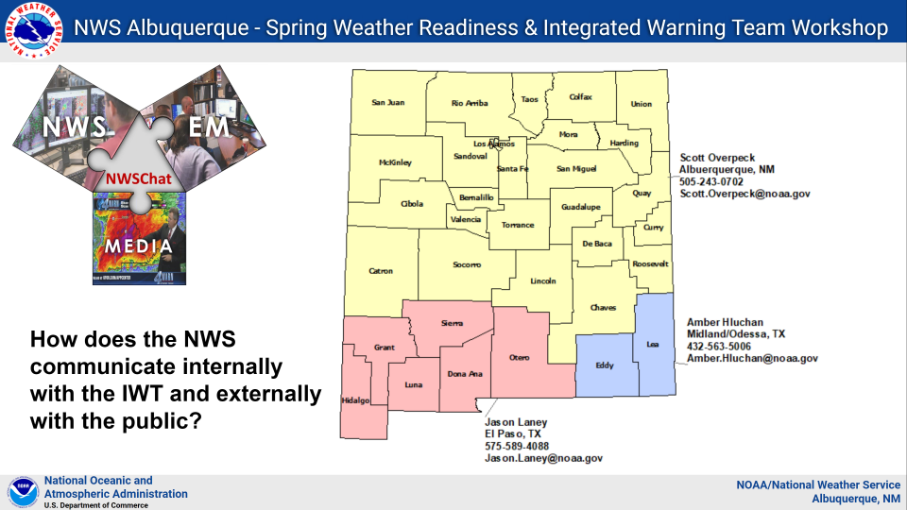
Map of NWS Districts

Slide 3
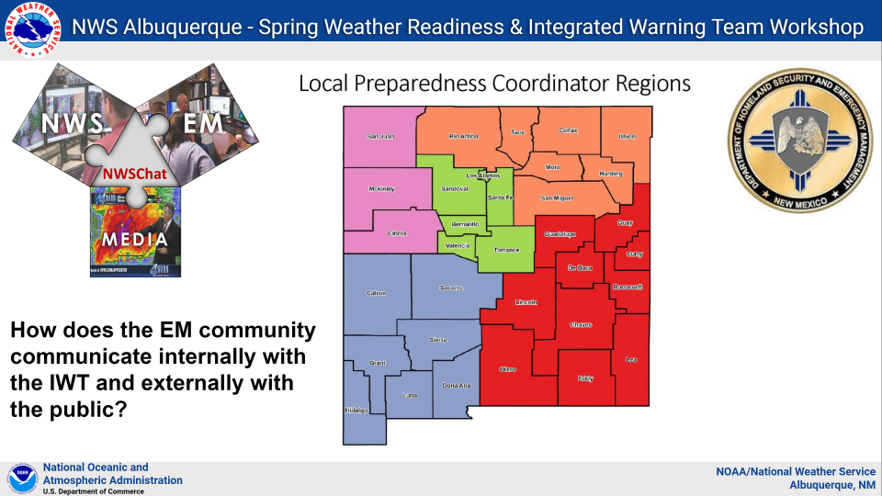
Map of Local Preparedness Districts

Slide 4
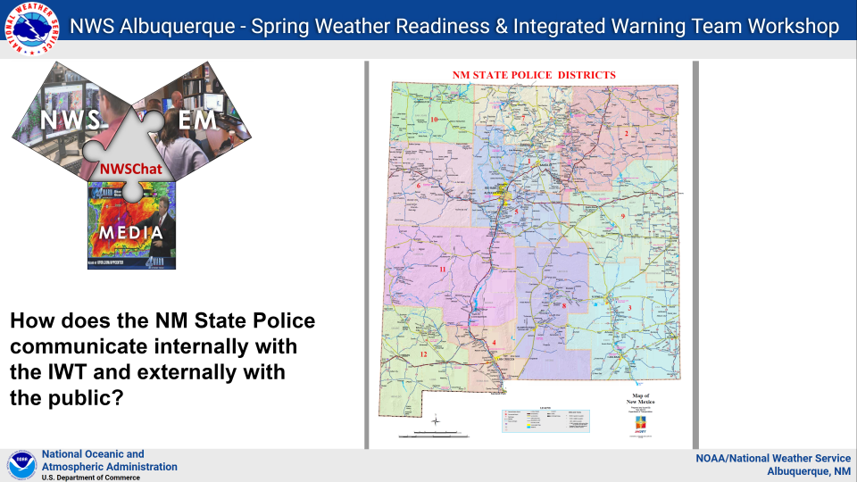
Map of NMSP Districts

Slide 5
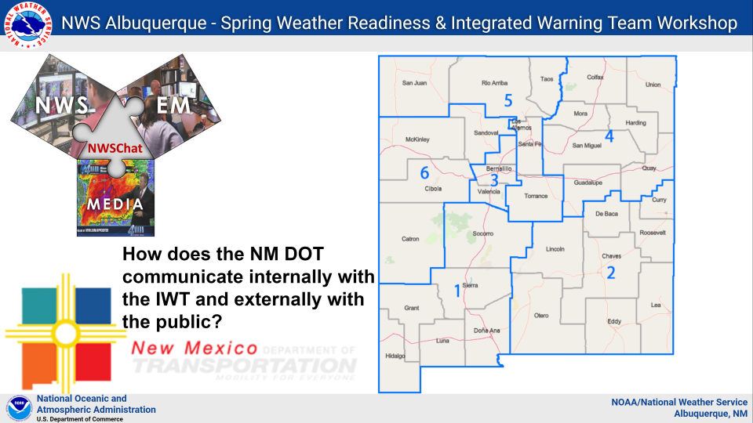
Map of DOT Districts

Slide 6
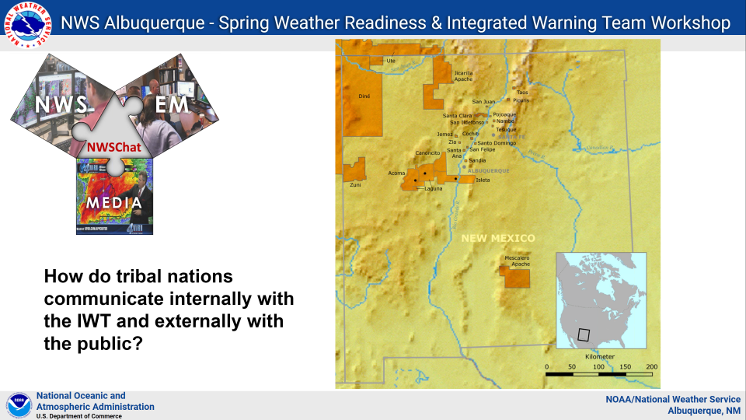
Map of Tribal Areas

Slide 7
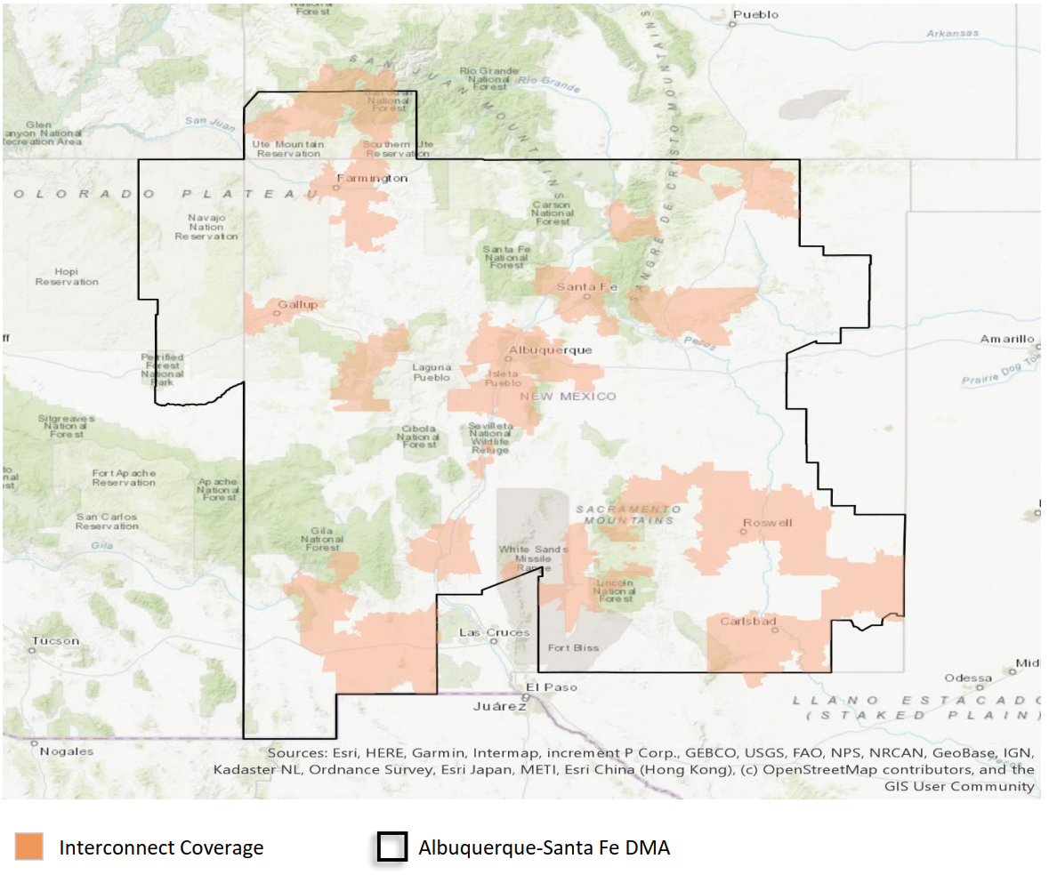
Map of Media Coverage Areas

Slide 8
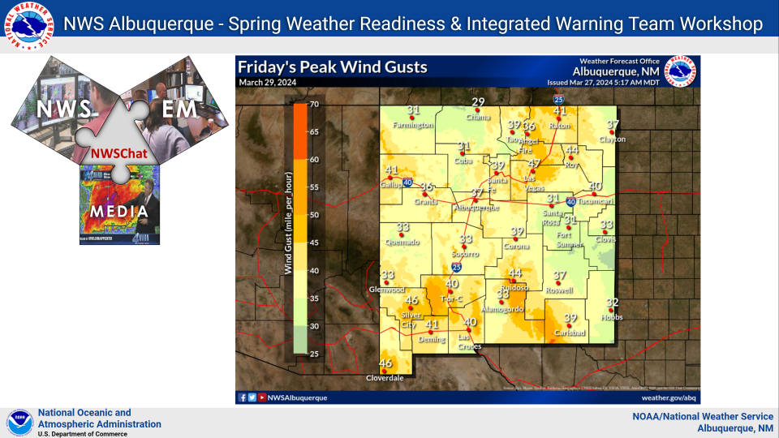
Wind Map Example

Slide 9
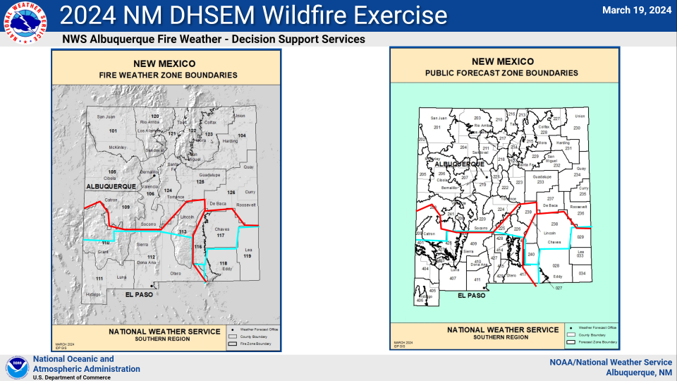
Maps of NWS Fire Zones

Slide 10
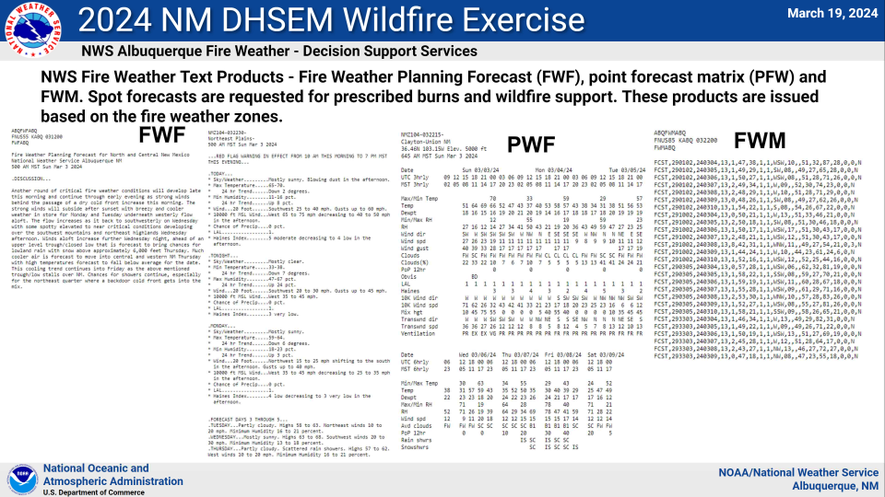
NWS Fire Text Product Examples

Slide 11
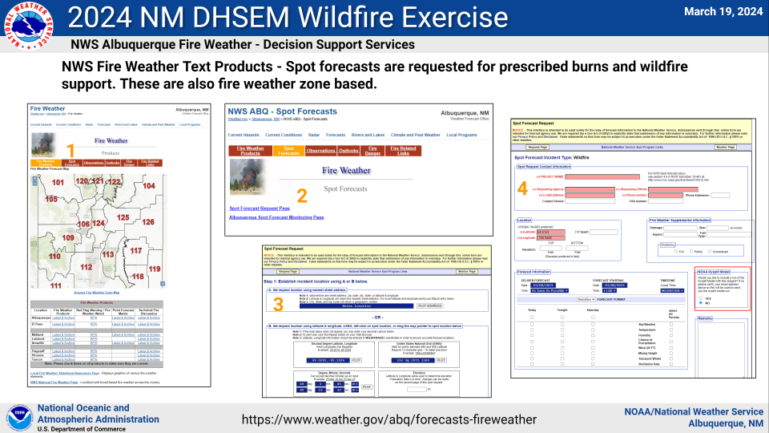
NWS Hotspot Notification Example

Slide 12
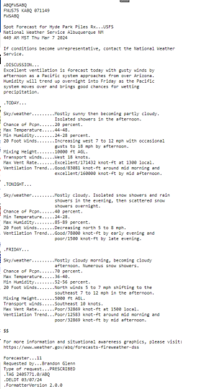
NWS Location Specific Fire Spot Forecast

Slide 13
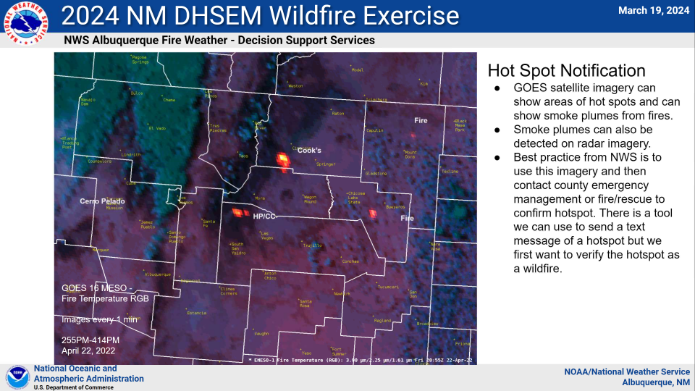
NWS Location Specific Fire Spot Forecast

Slide 14
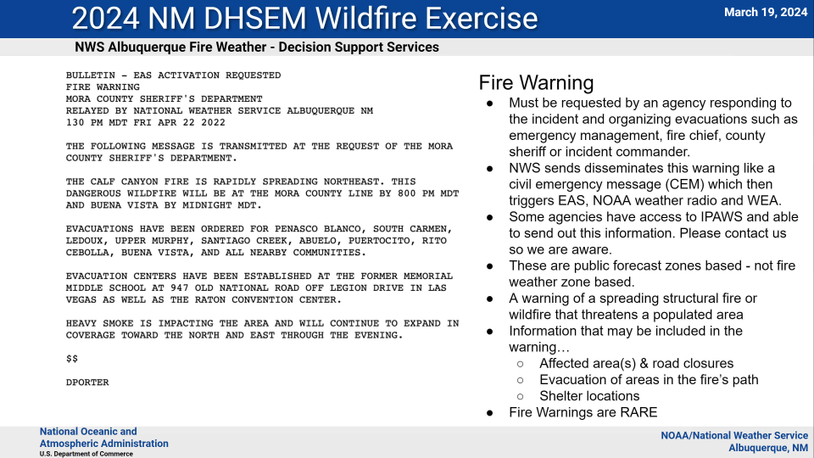
NWS Fire Warnings

Slide 15
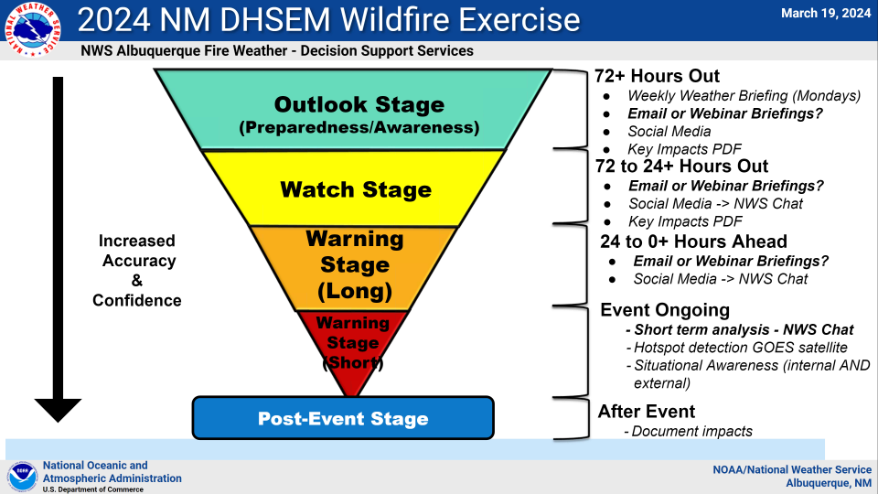
NWS Fire Response Stages

Slide 16
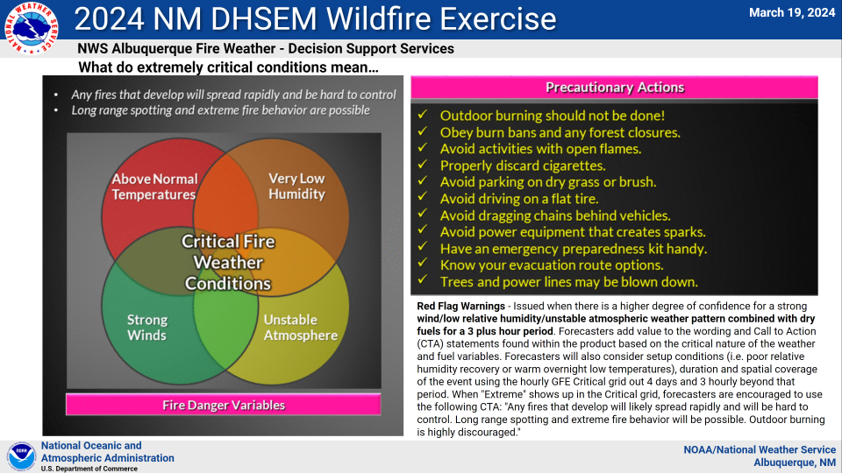
Extremely Critical Fire Conditions

Slide 17
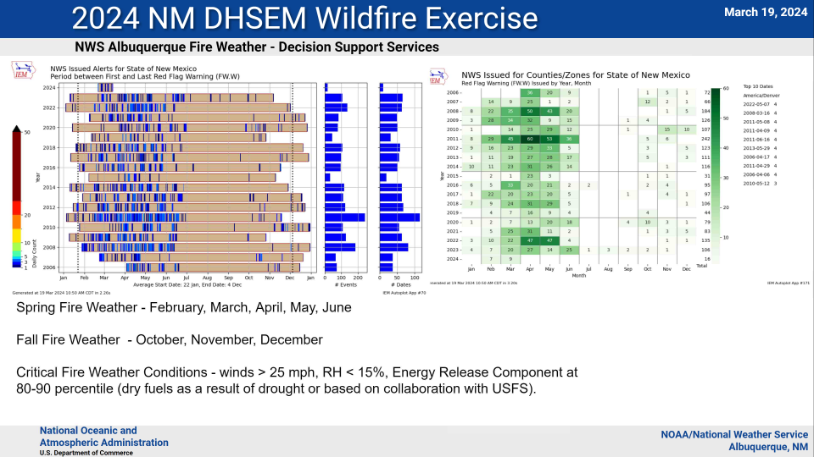
Frequency of Fire Warnings

Slide 18
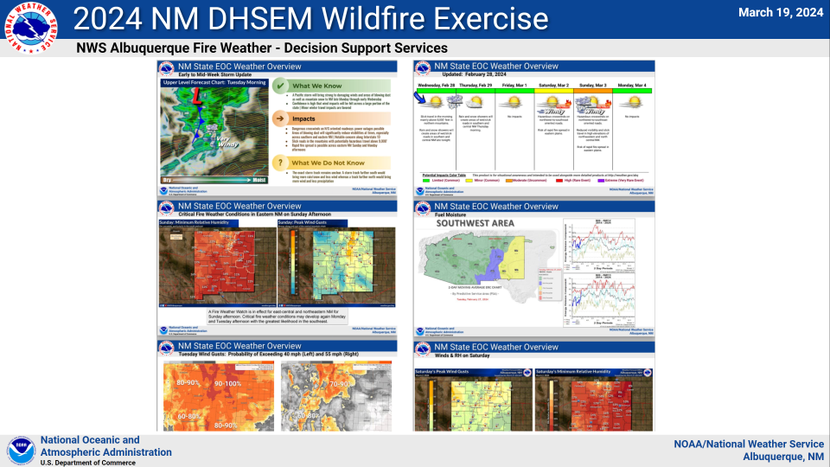
Fire Weather Overviews

Slide 19
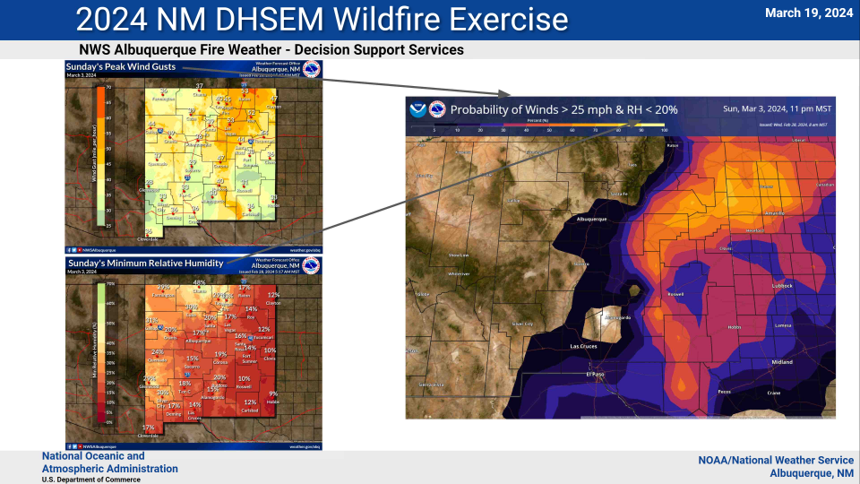
Combining Fire Forecasts

Slide 20
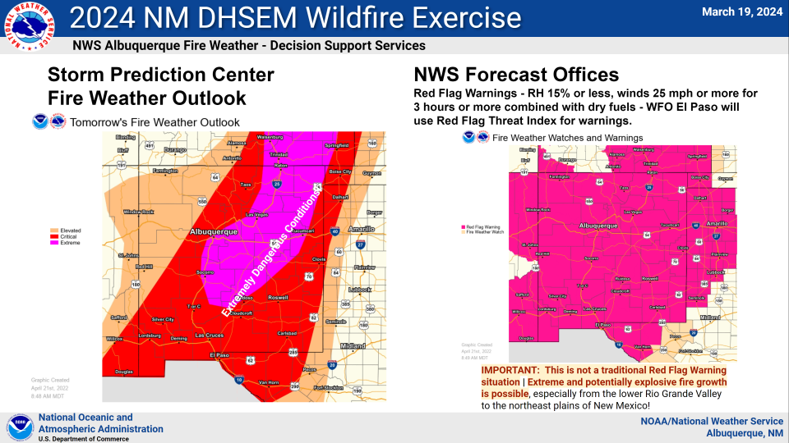
Differences in Fire Outlooks

Slide 21
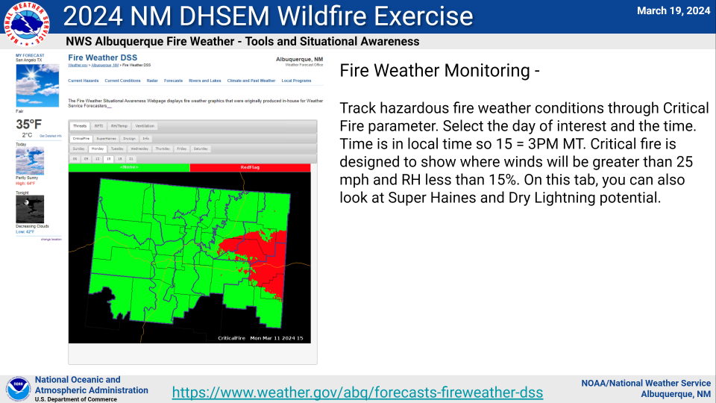
NWS Fireweather DSS Website

Slide 22
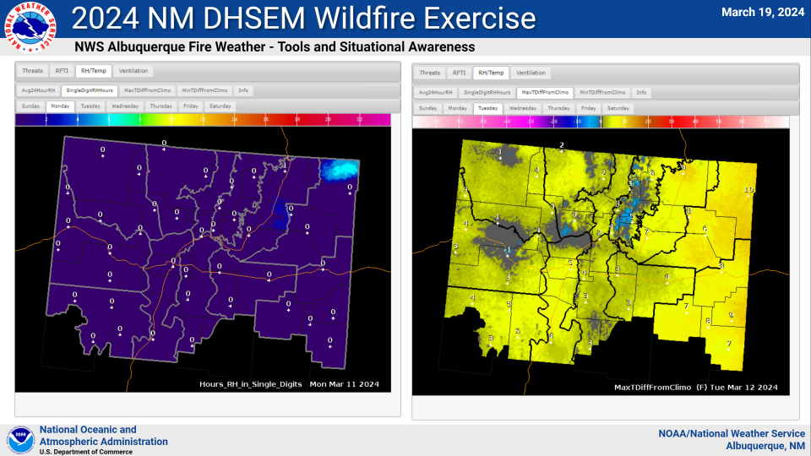
NWS Fire Weather Tools (1)

Slide 23
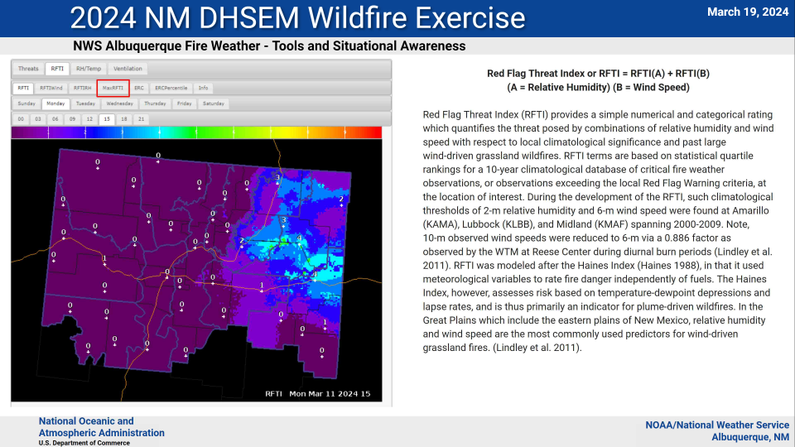
NWS Fire Weather Tools (2)

Slide 24
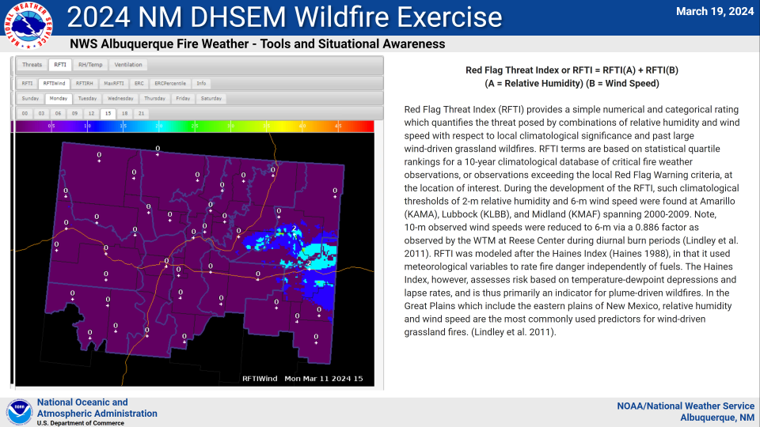
NWS Fire Weather Tools (3)

Slide 25
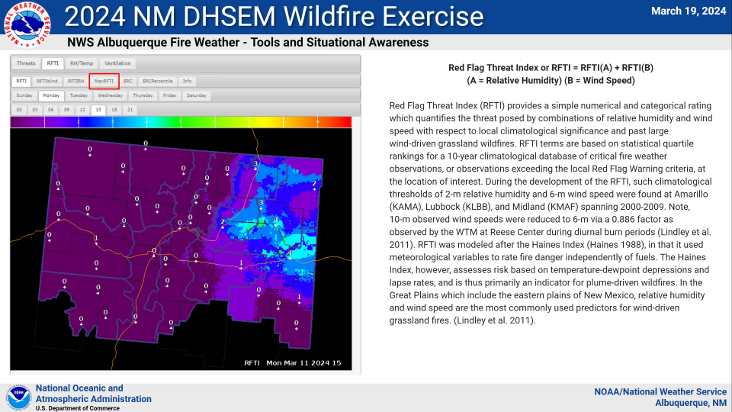
NWS Fire Weather Tools (4)

Slide 26
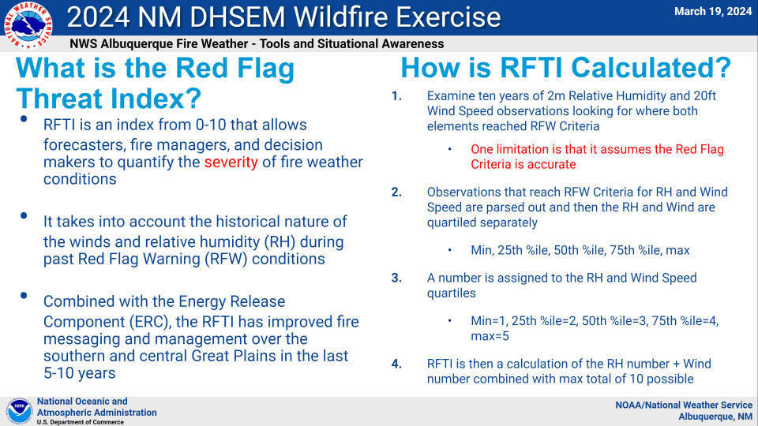
Red Flag Threat Index

Slide 27
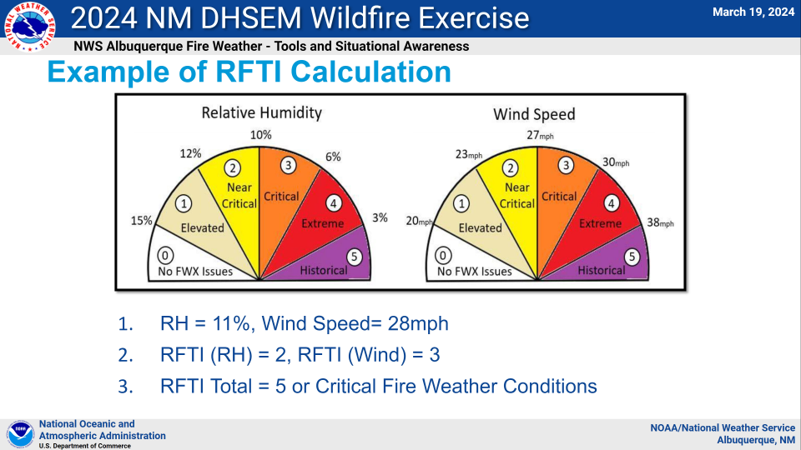
RFTI Calculation Example

Slide 28
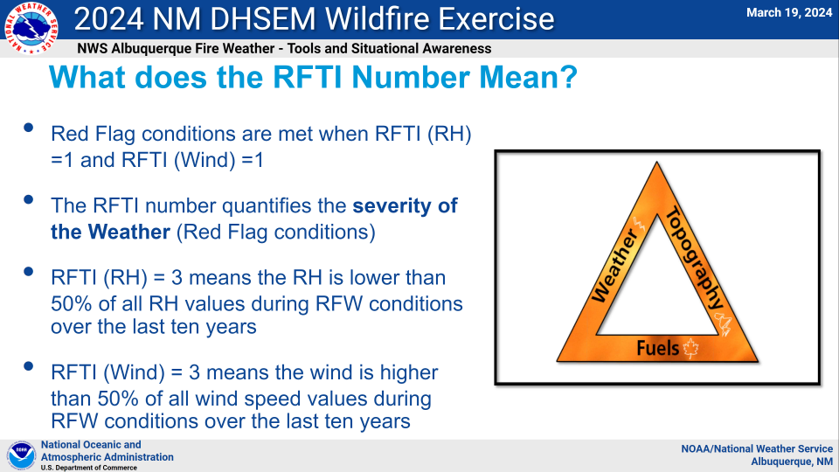
RFTI Number meaning

Slide 29
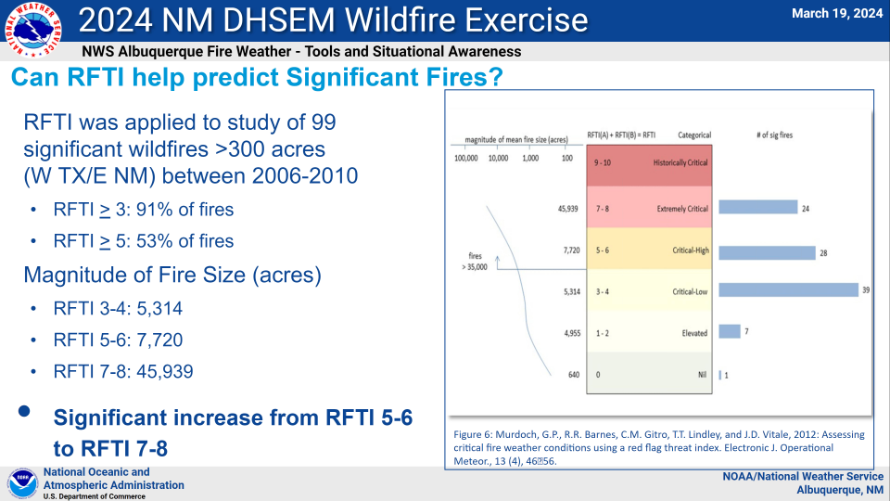
RFTI correlated with Fires

Slide 30
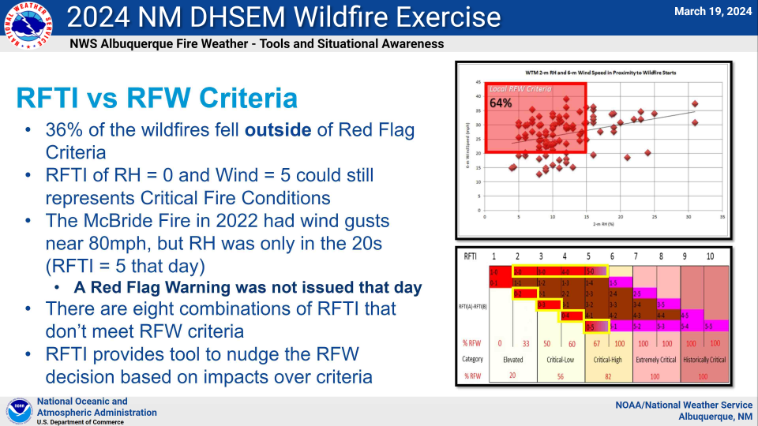
RFTI vs Red Flag Warning

Slide 31
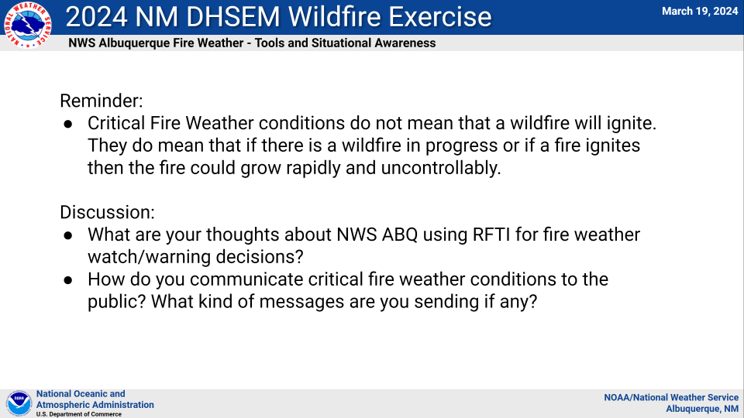
Fire Weather Summary

Slide 32
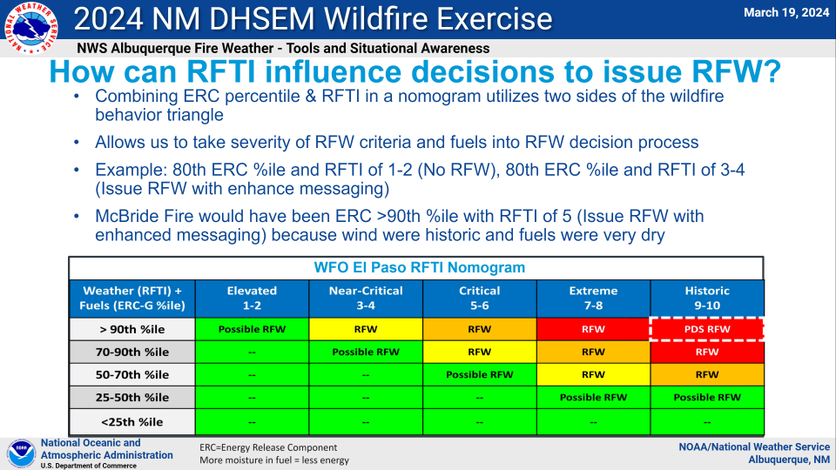
Fuel Moisture factor

Slide 33
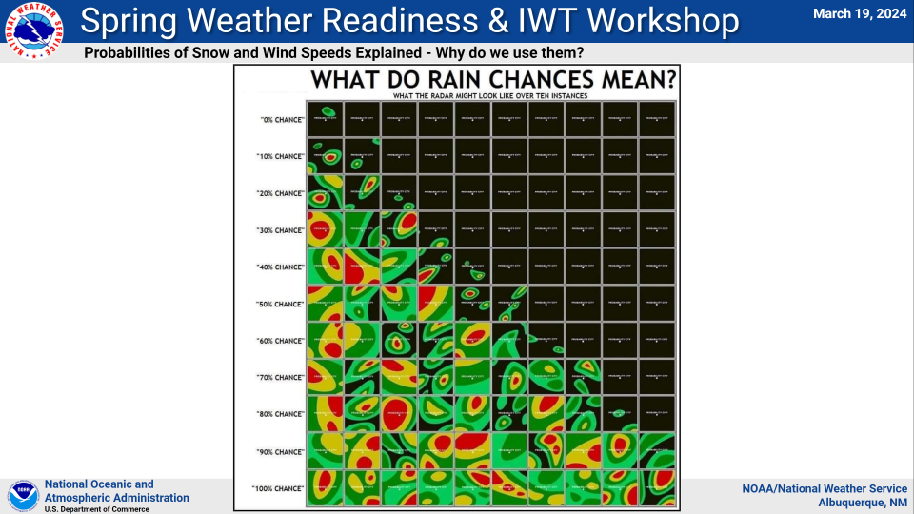
Precipitation Pattern Chances

Slide 34
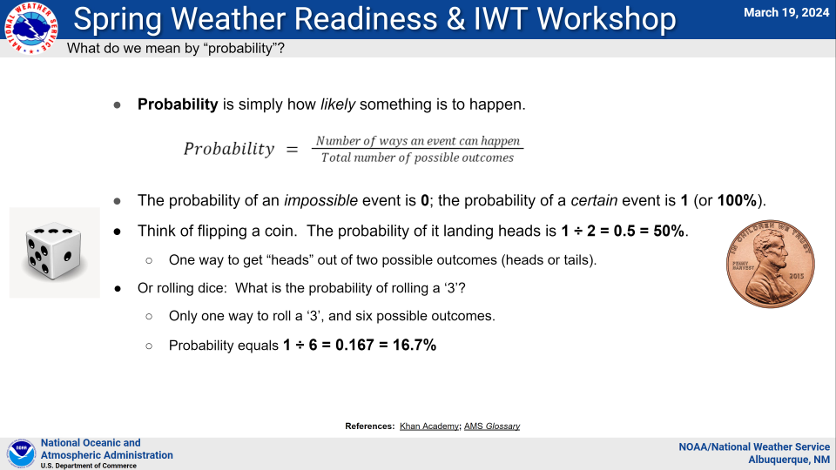
Precipitation Probability

Slide 35
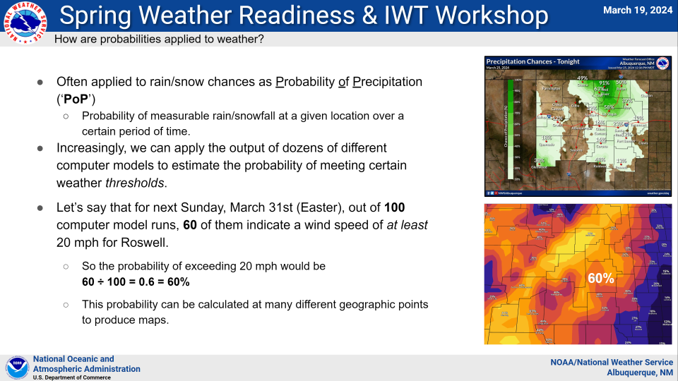
Probability of Precipitation (PoP)

Slide 36
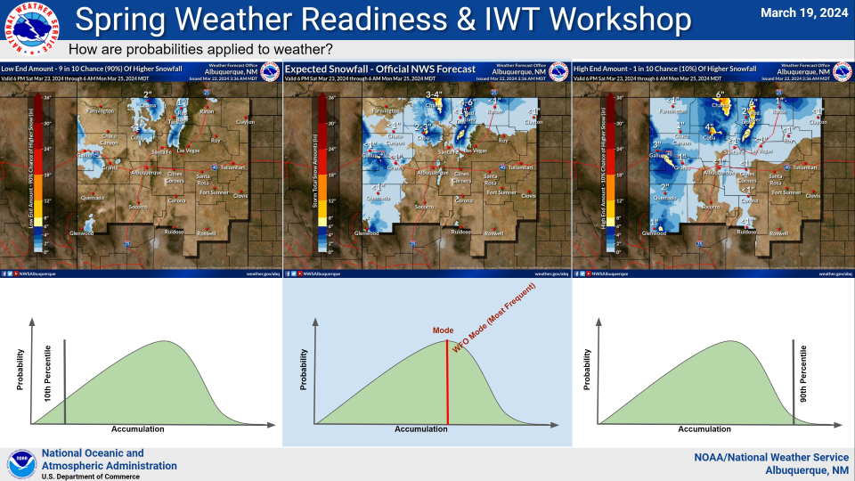
Precipitation Range Forecast

Slide 37
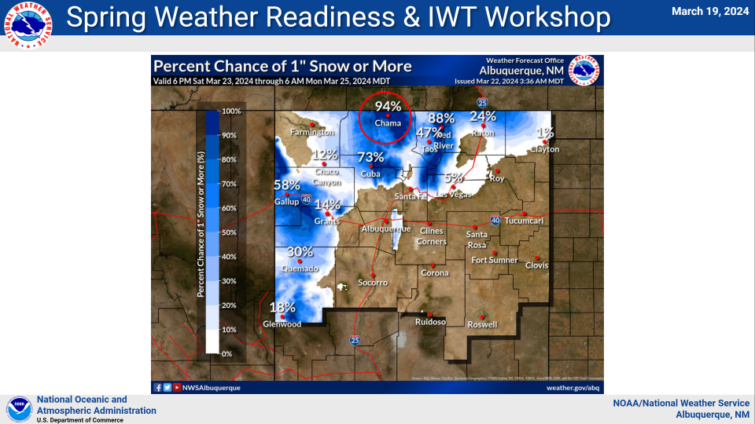
Precip by Amount Based Example1

Slide 38
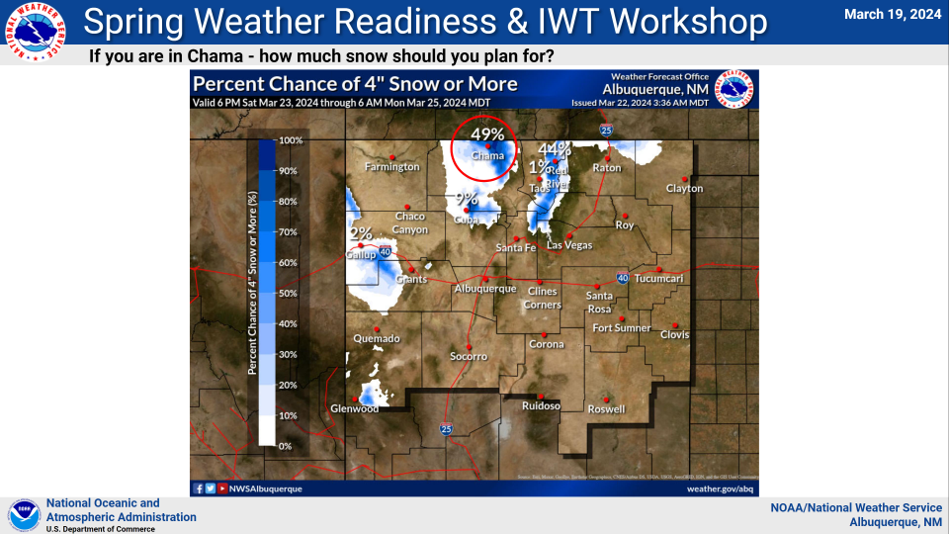
Precip by Amount Based Example2

Slide 39
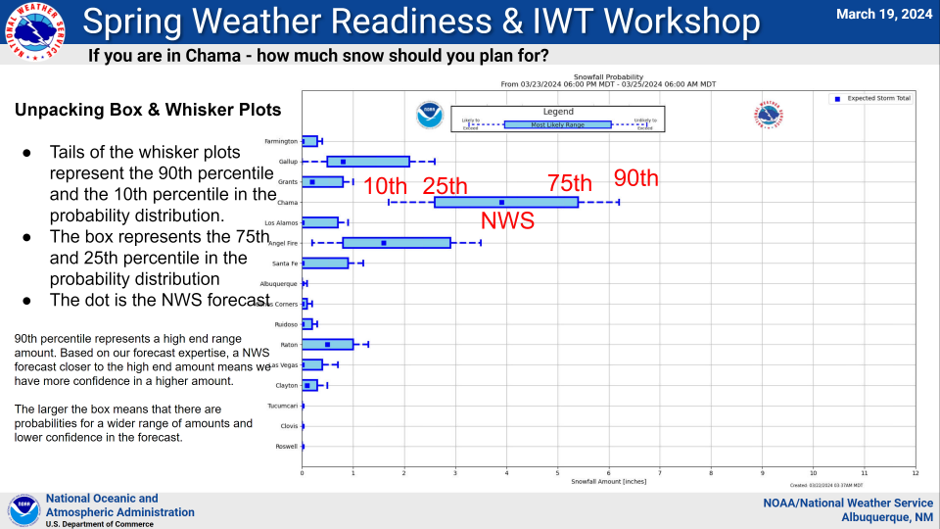
Precip Box & Whisker Plot

Slide 40
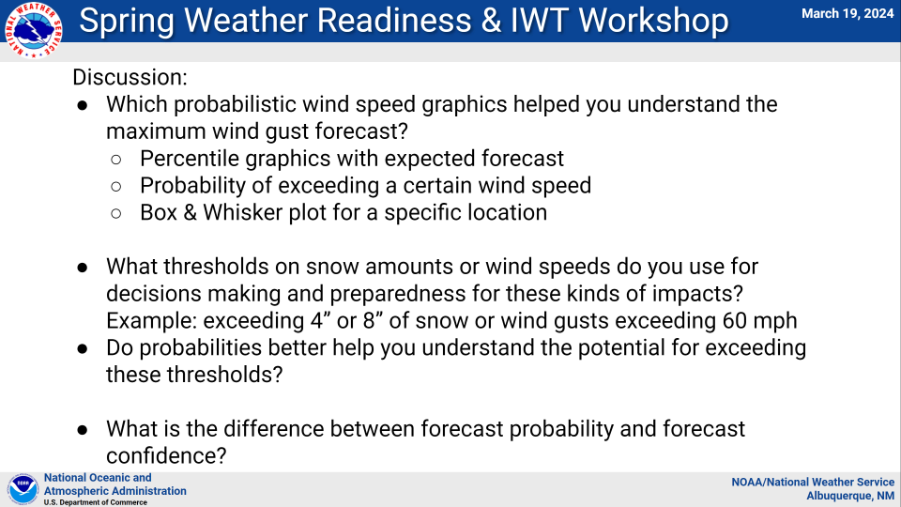
Precip vs Wind Discussion

Slide 41
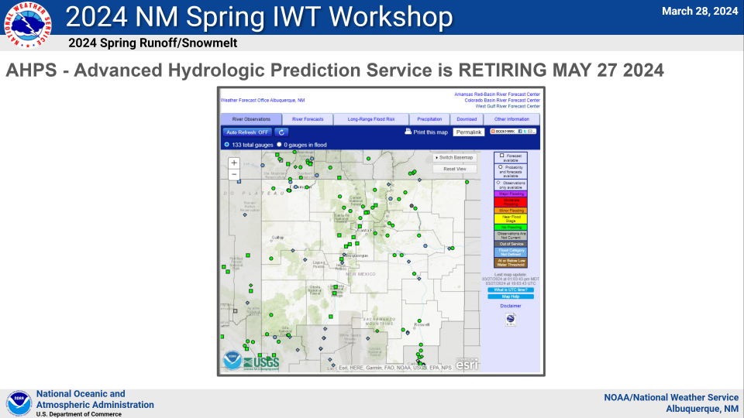
Advanced Hydro Prediction Service being retired

Slide 42
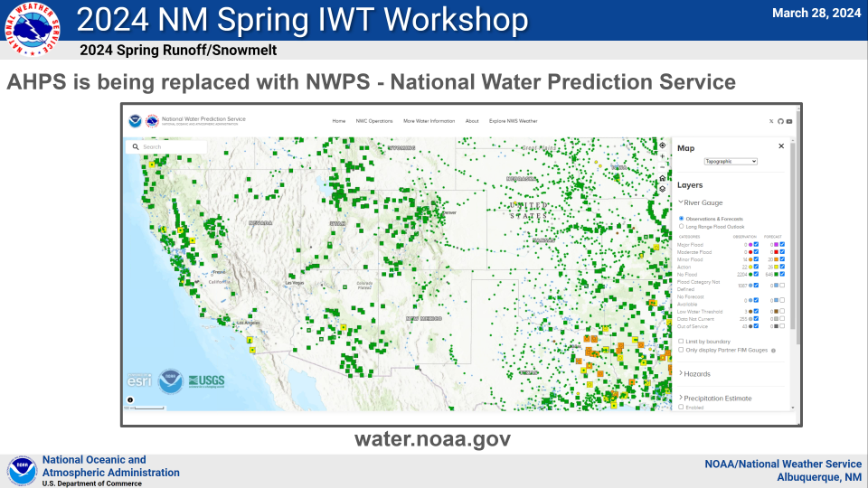
National Weather Prediction Service being instituted

Slide 43
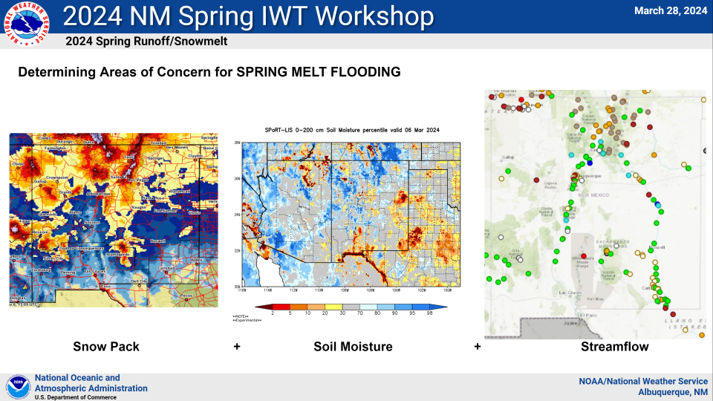
Determining Areas Of Flood Concern

Slide 44
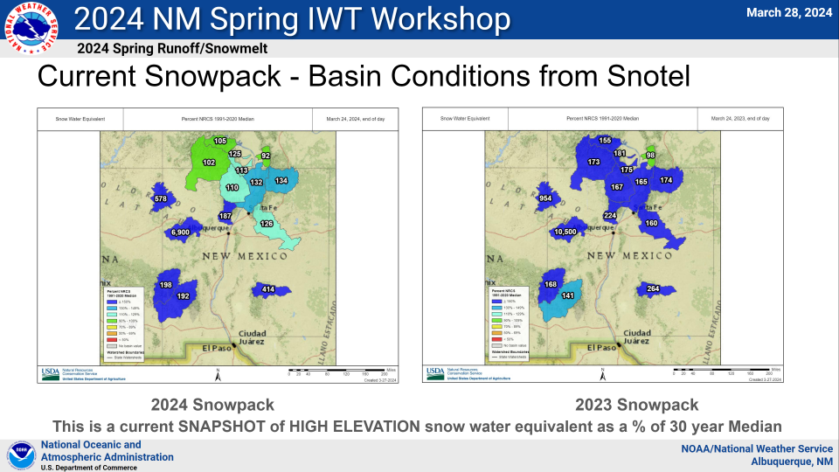
2024 vs 2023 Snowpack

Slide 45
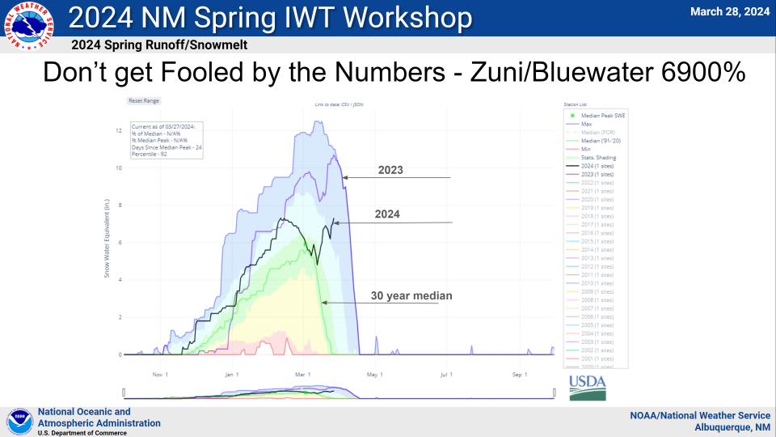
Bluewater Snowpack-Runoff Potential

Slide 46
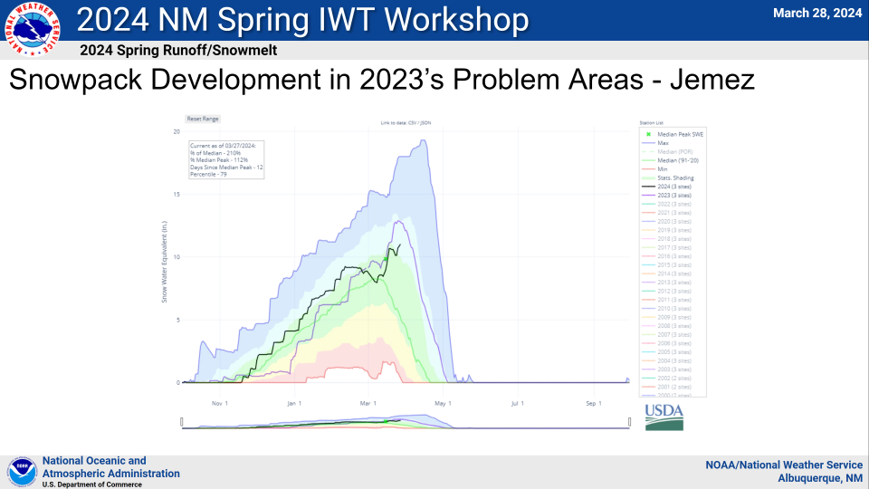
Jemez Snowpack-Runoff Potential

Slide 47
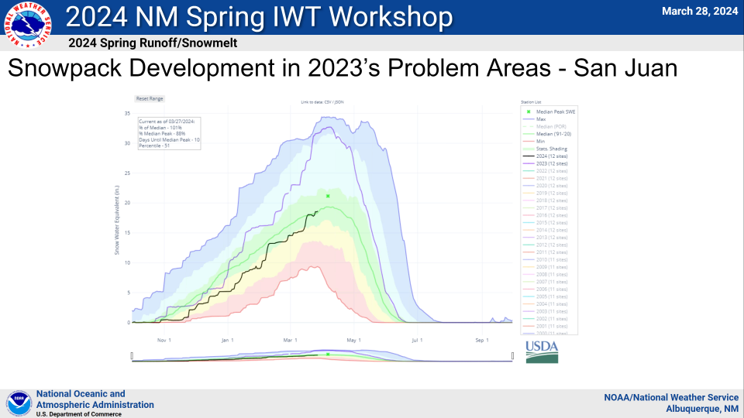
San Juan Snowpack-Runoff Potential

Slide 48
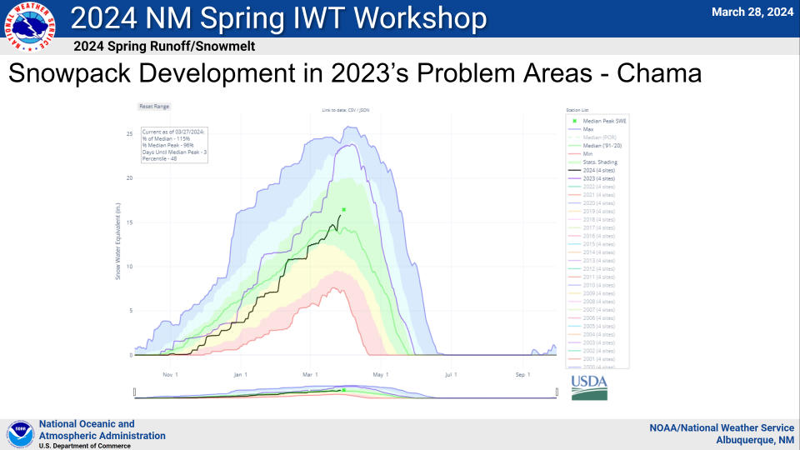
Chama Snowpack-Runoff Potential

Slide 49
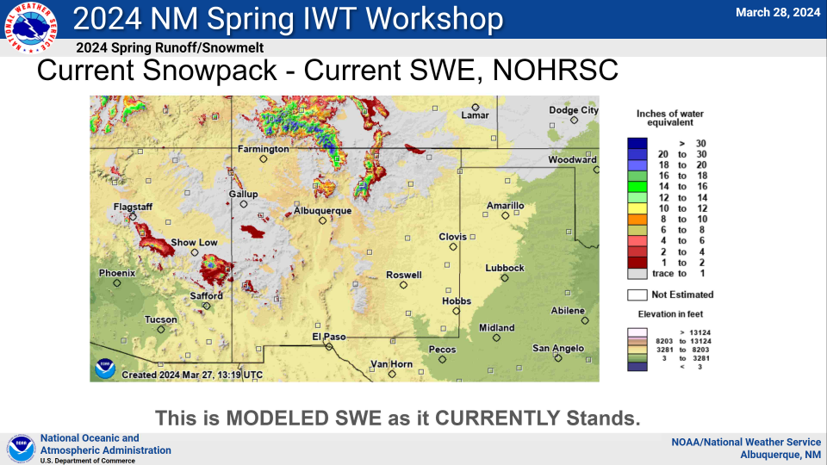
Current Regional Snowpack

Slide 50
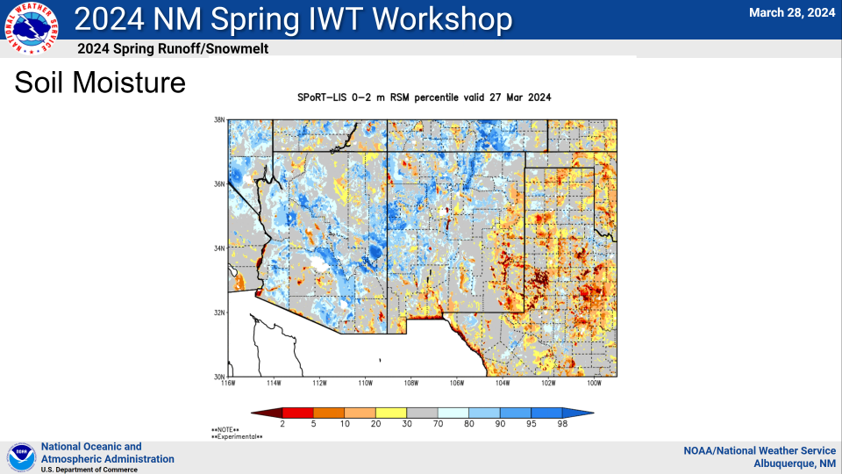
Current Soil Moisture

Slide 51
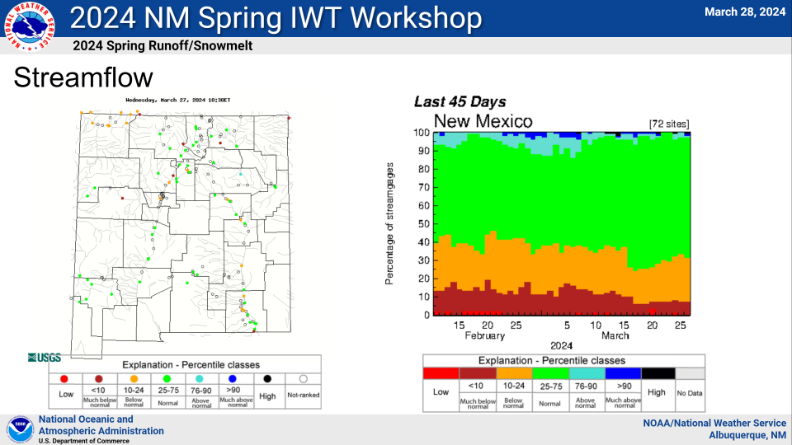
Current Streamflow

Slide 52

Spring Flooding Concerns

Slide 53

Increased Runoff Causes

Slide 54

8-14 Day Forecast

Slide 55

3-4 Week Forecast

Slide 56

Seasonal Forecast

Slide 57

Precip-Runoff Wrapup

Slide 58

Flash Flood Impact Tags

Slide 59

Impact Based Warnings

Slide 60

Proposal to Eliminate Flood Warnings

Slide 61

Attendees Poll

